Slide 1
SciSharp Stack Overview
Visualization
Jupyter-core
Matplotlib.Net
Plot.NET
NLP Support
BotSharp
SpaCy.NET
CherubNLP
High Level APIs
Keras.NET
scikit-learn.net
TFLearn.NET
.NET Based ML Framework
TensorFlow.NET
Torch.NET
Mxnetlib
Computation SDKs
NumSharp
Pandas.NET
Bigtree.Algorithm
Supporting Tools
CodeMinion
SciSharpCube
……

Slide 2


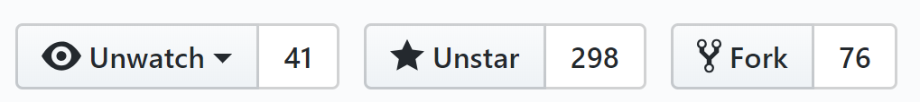
SciSharp Stack Snapshot
TensorFlow.NET
.NET Standard bindings for Google's TensorFlow for developing, training and deploying Machine Learning models in C#.
BotSharp
The Open Source AI Chatbot Platform Builder in 100% C# Running in .NET Core with Machine Learning algorithm.
Keras.NET(New)
Keras.NET is a high-level neural networks API, written in C# with Python Binding and capable of running on top of TensorFlow, CNTK, or Theano.
NumSharp
High Performance Computation for Tensor in .NET, keep APIs same as NumPy and SciPy.
SiaNet
A C# deep learning library, human friendly, CUDA/OpenCL supported, well structured, easy to extend
As of 6/28, 2019

Slide 3
Statistics
 | Stars | Forks | Downloads
TensorFlow.NET | 435 | 88 | 3,607
NumSharp | 460 | 72 | 7,089
Torch.NET | 15 | 3 | 33
Keras.NET | 17 | 2 | 177
Pandas.NET | 132 | 15
BotSharp | 660 | 142 | 3,202
CodeMinion | 8 | 2
Numpy.NET | 17 | 4
Gym.NET | 3 | 0
ICSharpCube | 24 | 7 | 561
ICSharpCore | 13 | 2
SiaNET | 298 | 76 | 4,762
Plot.NET | 18 | 0
Pandas.NET | 119 | 12
Scikit-Learn.NET | 14 | 3
Bigtree.Algorithm | 30 |  | 1,247
CherubNLP |  |  | 1,110
OpenAIGym.NET
 | 2,263 | 428 | 21,788
As of 6/28/2019

Slide 4

What’s Tensorflow.NET?
Google Provided
Community Provided
SciSharp Providing
TensorFlow
Wrapper
C++ Front End
Python Front End
JS Front End
Tensorflow.NET
……
Core TensorFlow Execution System
CPU
GPU
Android
iOS
……
.NET Standard bindings for Google's TensorFlow for developing, training and deploying Machine Learning models in C#.
APIs are kept as similar as possible you can immediately adapt any existing Tensorflow code in C# with a zero-learning curve.

Slide 5
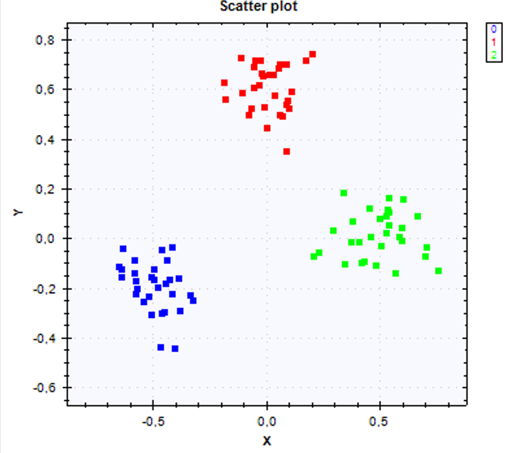
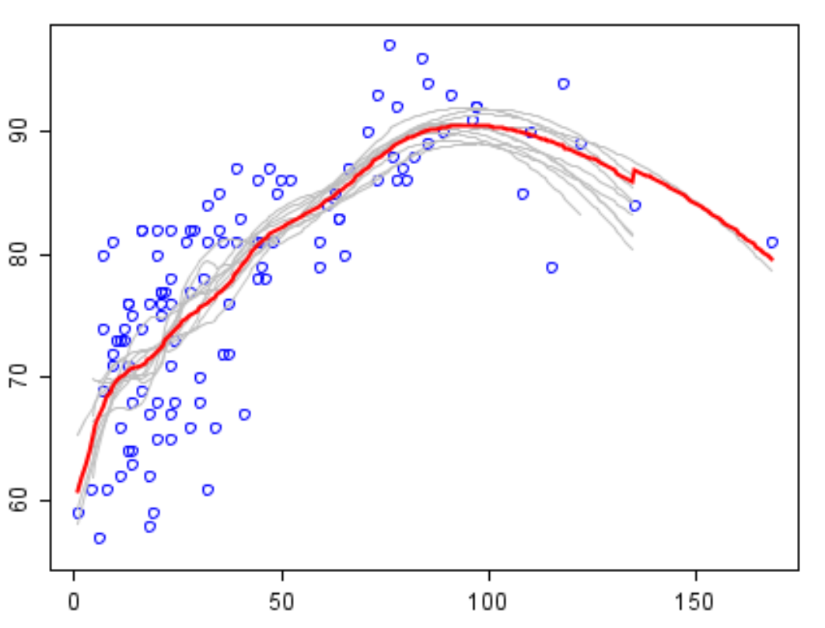
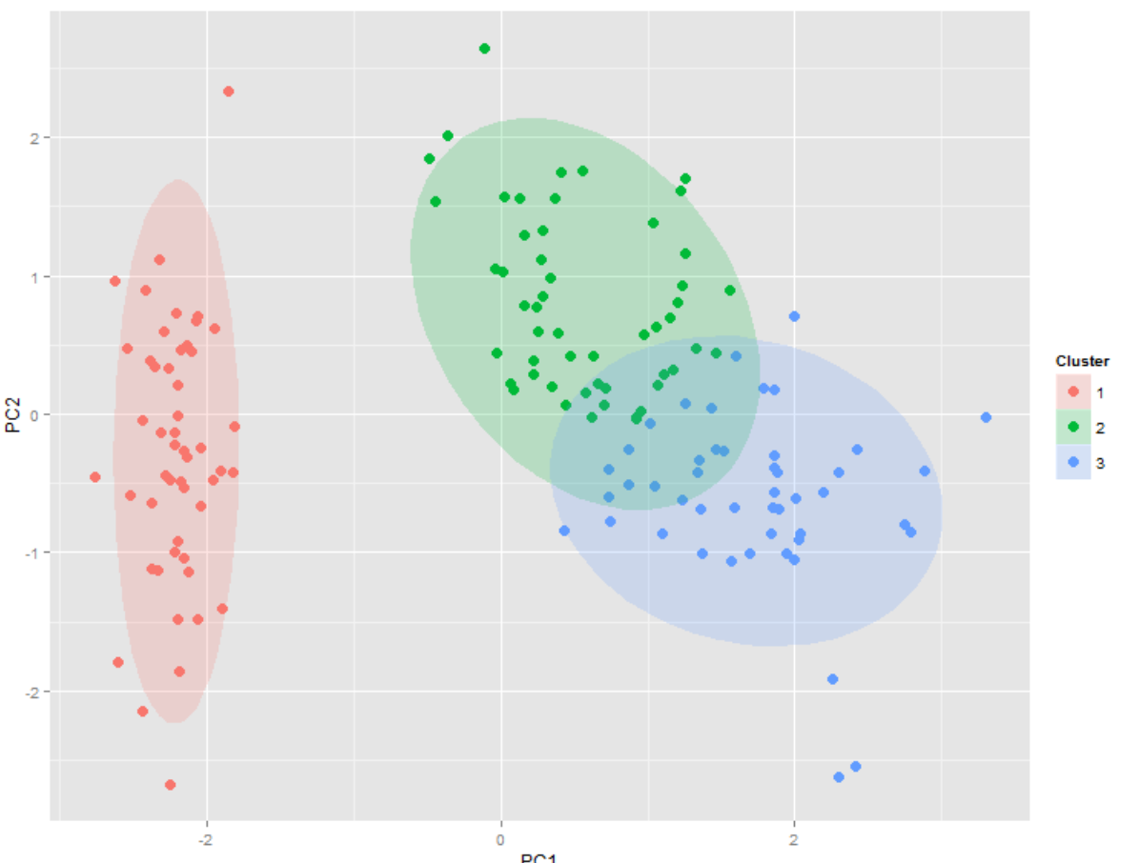
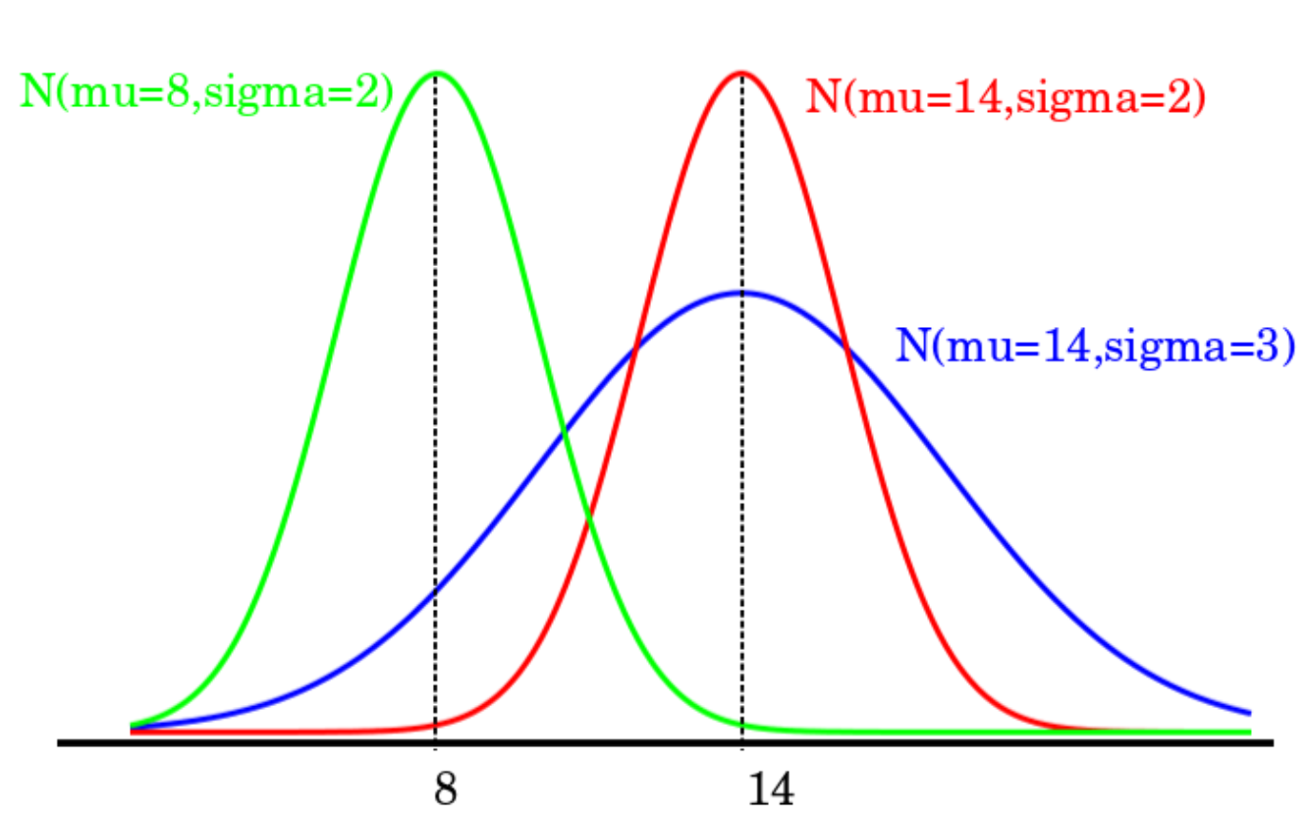
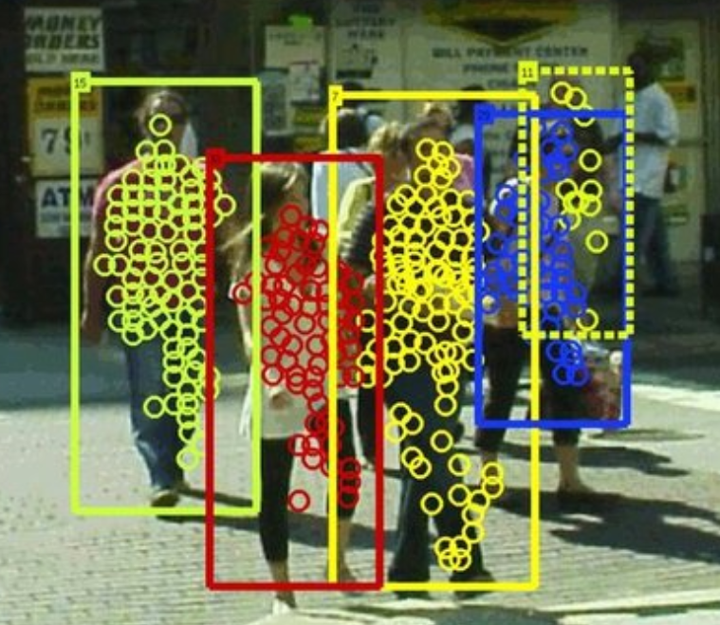
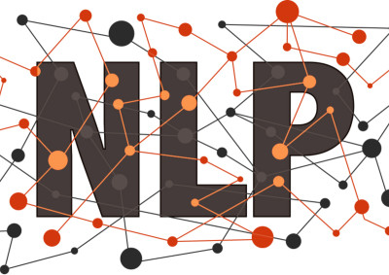
Use Cases with Tensorflow.NET Support
Regression
Clustering
Classification
Distributions
Imaging
Nature Language Processing
We provide sample codes for Linear Regression, Logistic Regression, Nearest Neighbor, Naive Bayes Classification, Image Recognition, K-means Clustering, Object Detection, Text Classification, CNN Text Classification, Named Entity Recognition, Transfer Learning, etc.

